Slide 1
SUNY Fredonia
Summer Construction

Slide 2
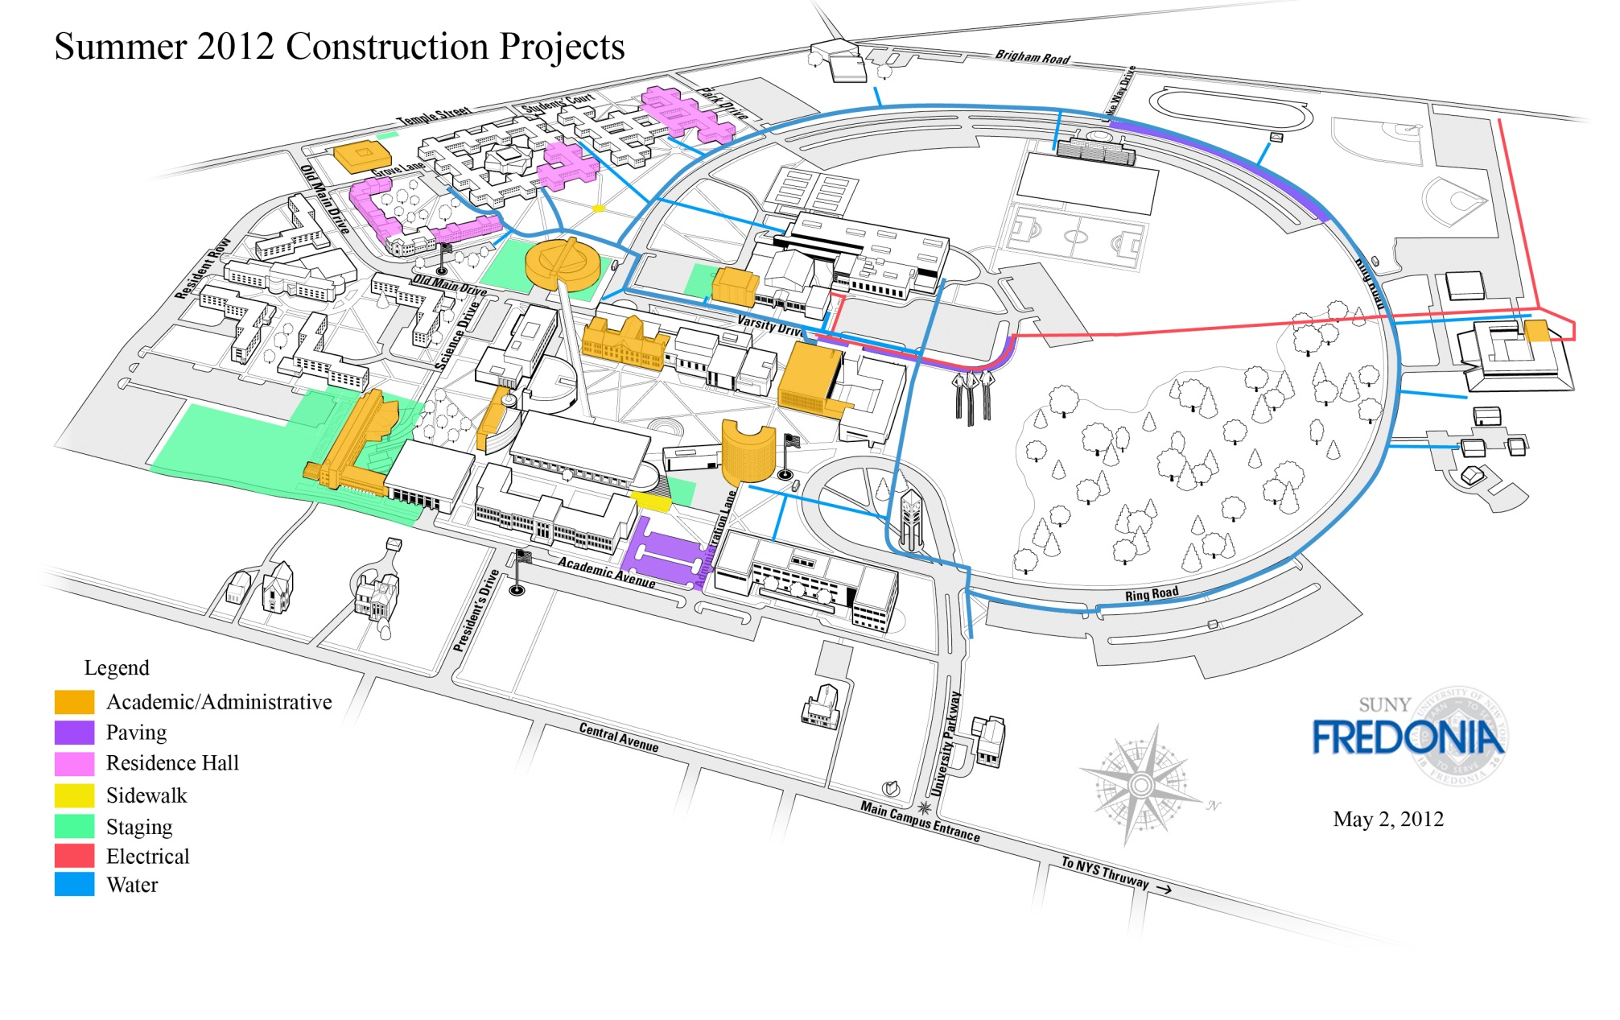
SUMMER 2012 CONSTRUCTION

Slide 3
Science Center

Slide 4
Science Center

Slide 5
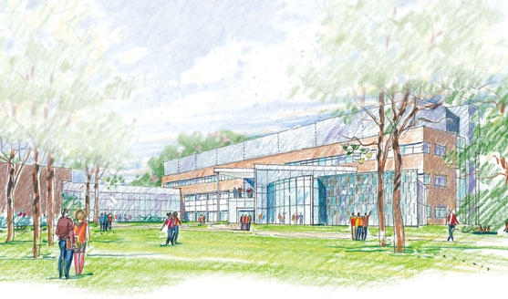
Science Center

Slide 6
Rockefeller Addition

Slide 7
Rockefeller Addition

Slide 8
Rockefeller Addition

Slide 9
Rockefeller Addition

Slide 10
Williams Center

Slide 11
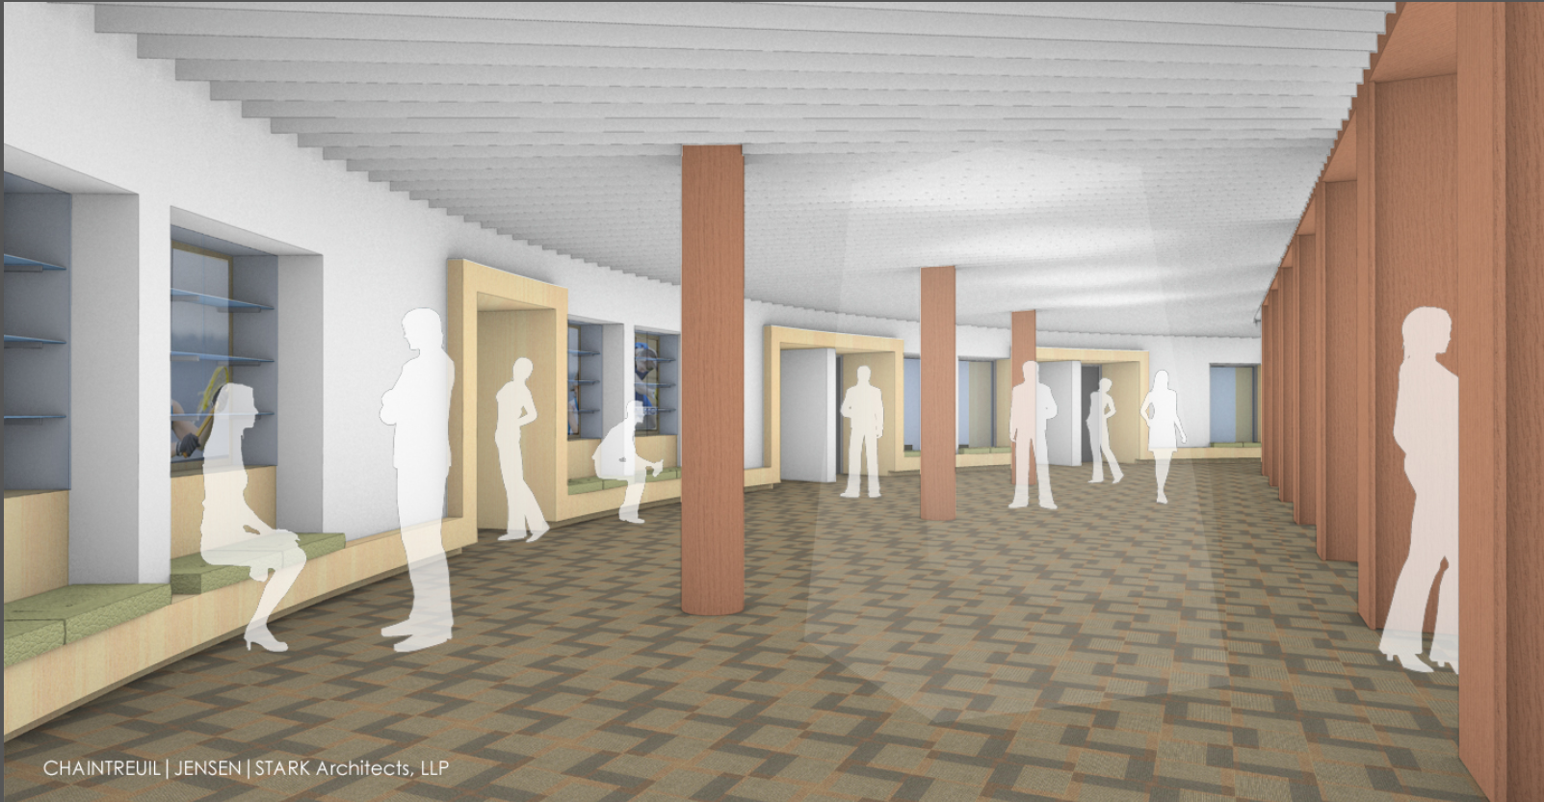
Williams Center

Slide 12
Williams Center

Slide 13
Williams Center

Slide 14
SUMMER 2012 CONSTRUCTION

Slide 15
Fitness Center

Slide 16
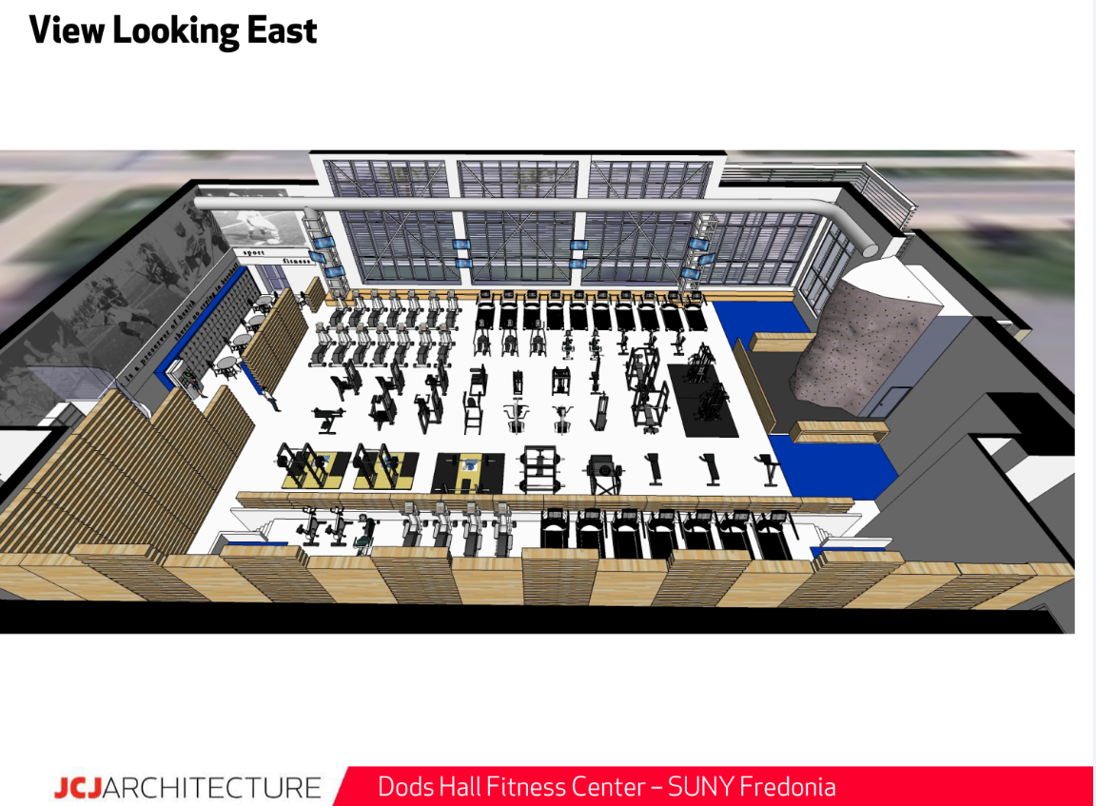
Fitness Center

Slide 17
Fitness Center

Slide 18
Fitness Center

Slide 19
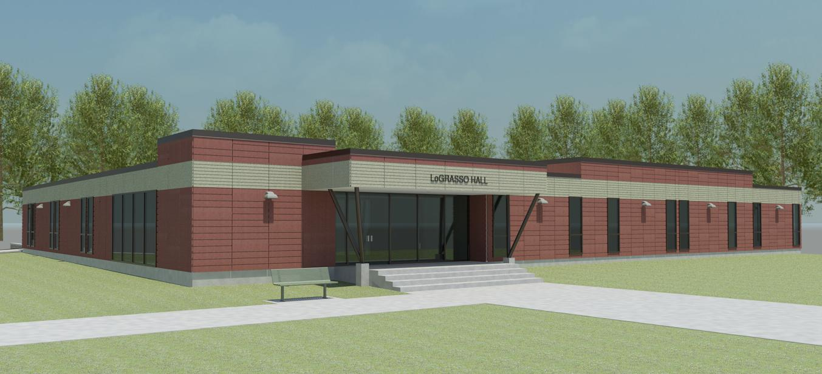
LoGrasso Hall

Slide 20
LoGrasso Hall

Slide 21
SUMMER 2012 CONSTRUCTION

