Slide 1
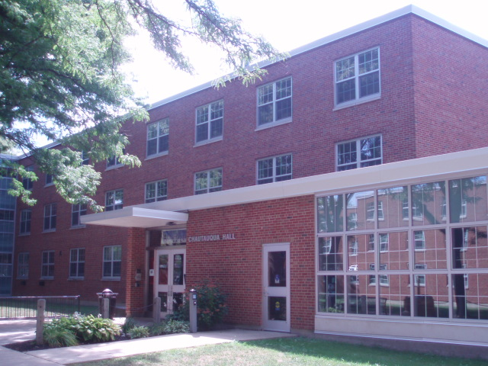
Chautauqua Hall Emergency Evacuation Scenario

Slide 2
The Scenario:
The campus has been experiencing intermittent electrical problems
One of the problems has been traced to a transformer and electrical switchgear in the basement of Chautauqua Hall.
An electrical contractor has been hired to make necessary repairs to the transformer and switchgear.

Slide 3
The Scenario (Continued):
The electrical contractor begins work on a Saturday morning at 8:00 am.
The contractor has assorted tools and equipment to bring in, and while doing so, has propped open several fire doors and smoke doors.

Slide 4
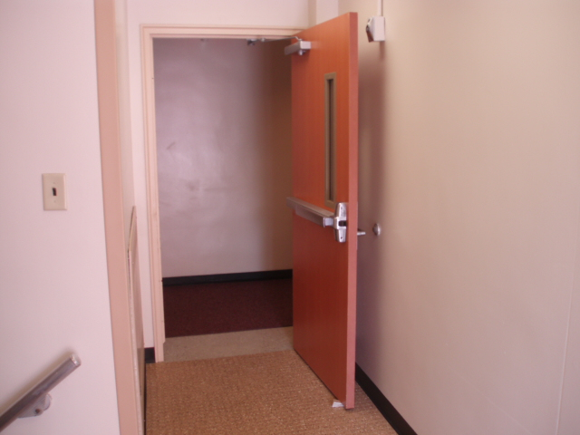

Slide 5
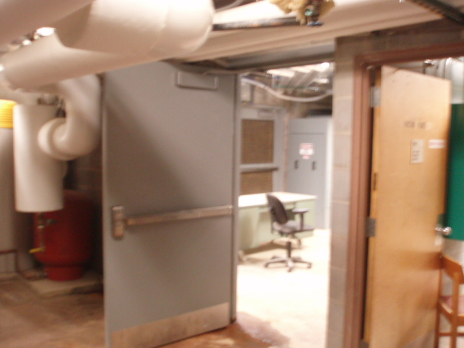

Slide 6
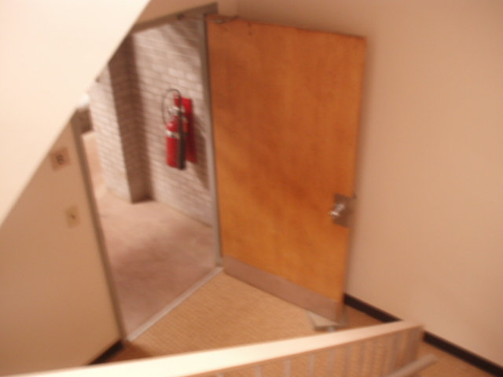

Slide 7
The Scenario (Continued):
At around 8:30, a worker does something wrong, and there is an explosion in the basement.
The transformer catches fire, producing large amounts of smoke.
The ensuing electrical short travels throughout the building, causing several subpanels to overheat and smolder.
Smoke detectors immediately activate the fire alarm.

Slide 8
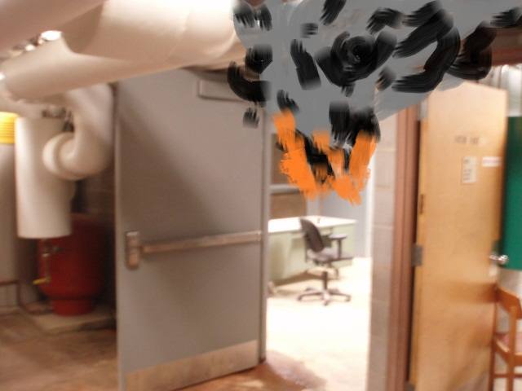

Slide 9
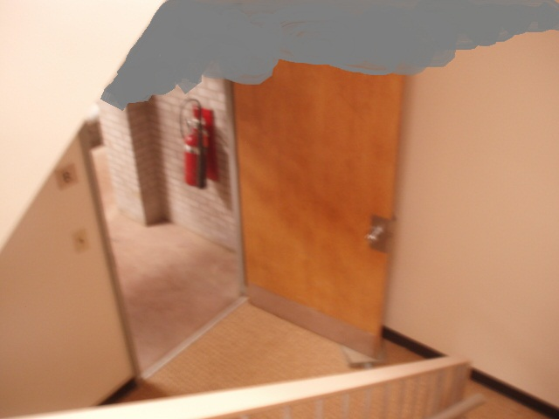

Slide 10
Given the scenario so far, what are some concerns you may have regarding the safety of occupants in the building?
1. ______________________________
2. ______________________________
3. ______________________________
4. ______________________________

Slide 11
Given the scenario so far, what are some concerns you may have regarding the safety of occupants in the building?
1. __Fire/smoke doors propped open__
2. __Possibility of fire/smoke on all floors_
3. __Time of day-people sleeping______
4. ______________________________

Slide 12
As the fire alarm sounds, you notice a smell of smoke.
What might some of your next actions be?
  1. ______________________________
  2. ______________________________
  3. ______________________________

Slide 13
As the fire alarm sounds, you notice a smell of smoke.
What might some of your next actions be?
  1.__Grab your RA Emergency Binder___
  2. __Feel the door before opening_____
  3. __Call U.P. to confirm smoke/fire____

Slide 14
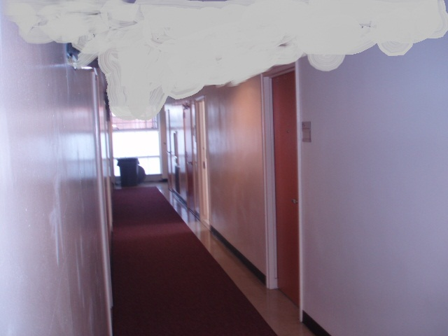
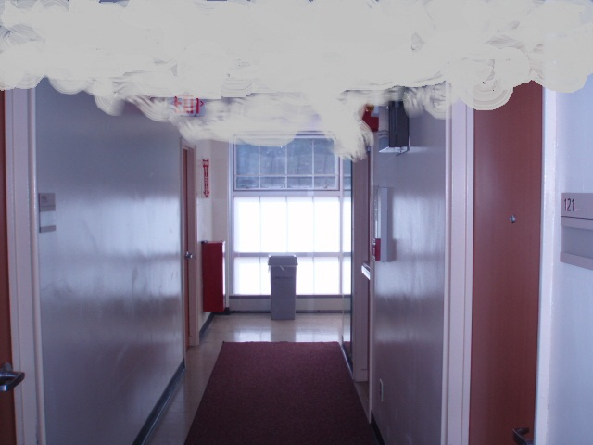
Hallway view from your room door (left and right)

Slide 15
What are some difficulties you may encounter while exiting the building?
1. _________________________________
2. _________________________________
3. _________________________________
4. _________________________________
5. _________________________________

Slide 16
What are some difficulties you may encounter while exiting the building?
1. __Poor visibility and air quality________
2. __Injured or overcome occupants_____
3. __Panicking occupants______________
4. __Fire is low, at level of egress________
5. __F.D. may be entering_____________

Slide 17
What are some of the concerns you may have regarding other occupants in the building?
1. _______________________________
2. _______________________________
3. _______________________________
4. _______________________________

Slide 18
What are some of the concerns you may have regarding other occupants in the building?
1. __Sleeping ______________________
2. __Think false alarm or fire drill______
3. __Don’t know what to do__________
4. _______________________________

Slide 19
In what ways might you be able to assist or notify other occupants of the building?
1. ______________________________
2. ______________________________
3. ______________________________
4. ______________________________

Slide 20
In what ways might you be able to assist or notify other occupants of the building?
1. __Shout “FIRE!”_________________
2. __Bang on doors________________
3. __Help handicapped or injured out_
4. ______________________________

Slide 21
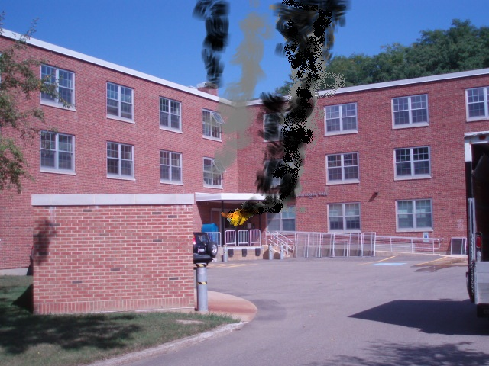

Slide 22
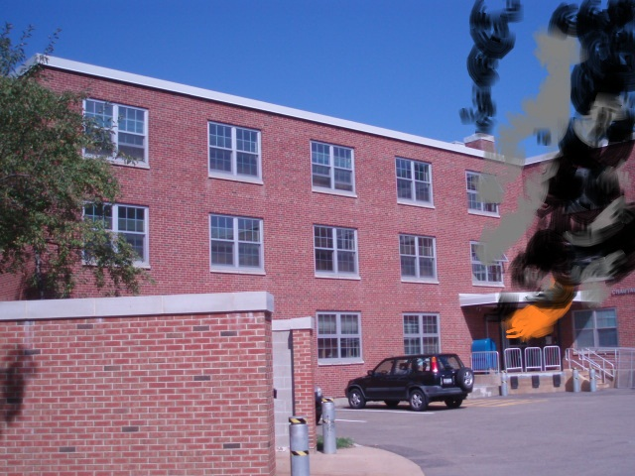

Slide 23
Once outside, what other problems might you encounter?
1. ______________________________
2. ______________________________
3. ______________________________
4. ______________________________

Slide 24
Once outside, what other problems might you encounter?
1. ___Fire Department Operations_____
2. ___People wanting to go back in_____
3. _People not reporting to assembly point
4. __Injured or overcome needing aid____

Slide 25
If you are trapped:
If you were trapped in your room, what actions would you take?
1. _______________________________
2. _______________________________
3. _______________________________
4. _______________________________

Slide 26
If you are trapped:
If you were trapped in your room, what actions would you take?
1. __Keep door closed, put towel under_
2. _Call U.P. or 911, inform of your location
3. __Hang sheet out of window_________
4. _Keep window closed as much as possible

Slide 27
Accountability
What potential accountability problems might you encounter?
1. ________________________________
2. ________________________________
3. ________________________________
4. ________________________________

Slide 28
Accountability
What potential accountability problems might you encounter?
1. _Persons not reporting to assembly point_
2. _Unknown whereabouts of all persons__
3. _Injured already transported to hospital__
4. _Need for secondary assembly point_(relocation)___

Slide 29
Summary:
A real fire or emergency situation may impose more obstacles to an orderly evacuation than a fire drill.
We must learn to be prepared for a real fire or emergency situation.
Utilize fire drills to brush up on your emergency preparedness training.

