Slide 1
Earn Travel Reward Points
Sandy Noble,
Director of University Accounting
2017 F&A Workshop – August 15, 2017

Slide 2
Earn “Points” by remembering
Employee reimbursements MUST be received in University Accounting within 30 business days of the traveler’s “Return Date.”
No exceptions!!
If traveler’s “main mode” of transportation is driving the traveler must follow Fredonia Policy #022 if seeking full mileage reimbursement.
No exceptions!!
Original receipts are required with Travel Voucher.
Proof of Attendance, Certificate of Completion or Name Badge and an Agenda must be submitted with Travel Voucher.
These items are written justification proving “business” and “attendance.”
OSC can audit any expense up to 7 years! Written justification is a must.

Slide 3
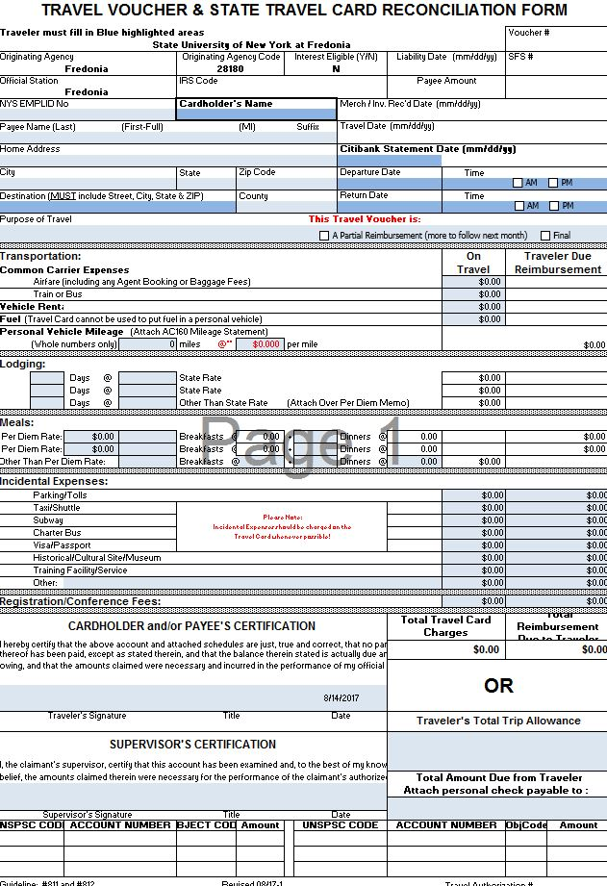
Earn “Points” by remembering (cont’d)
Fredonia has 210 Citibank Travel/NET Cards… please fill in “Cardholder Name” and “Statement Date” on the voucher.

Slide 4
Earn “Points” by remembering (cont’d)
“Allowable” expenses must be business expenses.
Personal and Business can be “mixed” on a trip, but traveler’s can only be reimbursed for the business portion of their trip.
“Other Funds” must be documented.
Fredonia cannot reimburse an expense that another agency is also reimbursing.
Trip Limits – our vendors will be paid before employee is reimbursed.
Traveler will only be reimbursed for what is allowable and up to the remaining Trip Limit balance.

Slide 5
New for 2017
As of July 1, 2017 State vehicles will be recharged at $0.48/mile.
Rate includes fuel (if the gas card in the glovebox is used) and E-ZPass tolls.
Students traveling – If NOT with a group and IS a state employee… the student’s NYS Employee number must be included on the voucher.
As of August 17, 2017 Office of State Comptroller will require Address of Destination, Departure and Return Dates, and Departure and Return Times recorded in military time.
OSC will reject any employee reimbursement that does not include the Street, City, State, and ZIP.

Slide 6
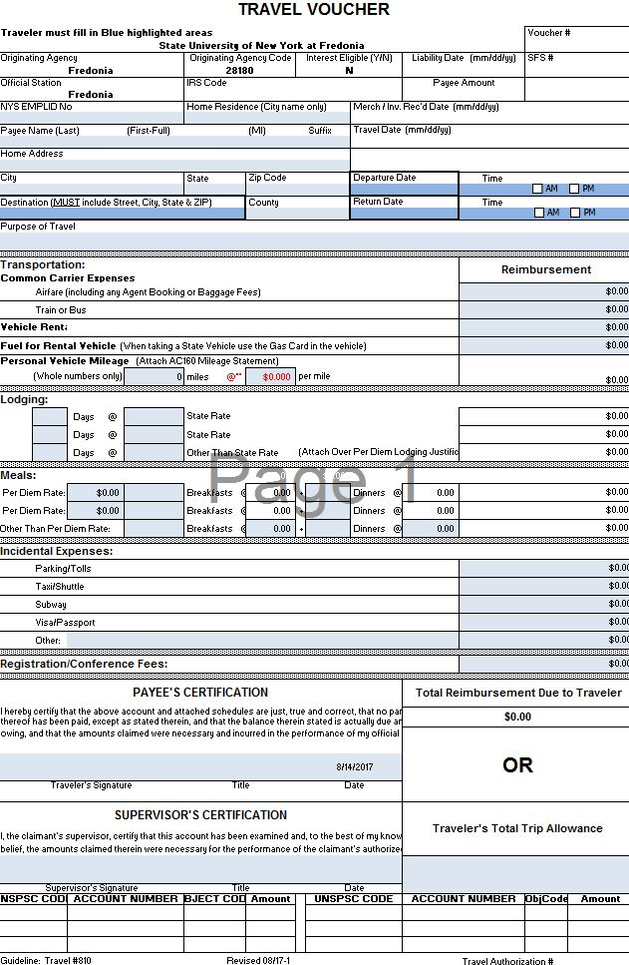

Slide 7
New for 2017 (cont’d)
OSC will begin to review the “Lesser of Mileage Rule” for trips including POV mileage reimbursement.
Determining Travel Status:
35 miles or greater. When traveler’s destination is 35 miles or more from both their home and official workstation, traveler is considered in Travel Status.
Travel Status is when meal and lodging reimbursements are “allowable” without question or special approval.
Less than 35 miles. When traveler is less than 35 miles from either their home or official workstation, traveler is NOT considered in Travel Status, but rather in “proximity” of official workstation.

Slide 8
“Proximity” Mileage
Mileage between an employee’s home and official workstation is considered normal commute miles and NEVER reimbursable.
When traveling in “proximity” of home of official workstation, an employee using a POV is entitled to reimbursement of miles from:
From home to alternate work location
Between the official and alternate workstation
Between alternate workstations
From alternate work locations to home

Slide 10
Contacting University Accounting
Questions?
Sandy Noble,
Director
Emily Parsons,
Accounts Payable Analyst
Alicia Klepfer,
Office Assistant 2
Sarah Chamberlain,
Student Office Assistant
Tel: 673-3467
Email: Accounting.Office@Fredonia.edu

